Slide 1
Data Link Control

Slide 2
FRAMING
The data link layer needs to pack bits into frames,, so that each frame is distinguishable from another.... Our postal system practices a type of framing. The simple act of inserting a letter into an envelope separates one piece of information from another; the envelope serves as the delimiter..
Topics discussed in this section:
Fixed-Size Framing Variable-Size Framing

Slide 3
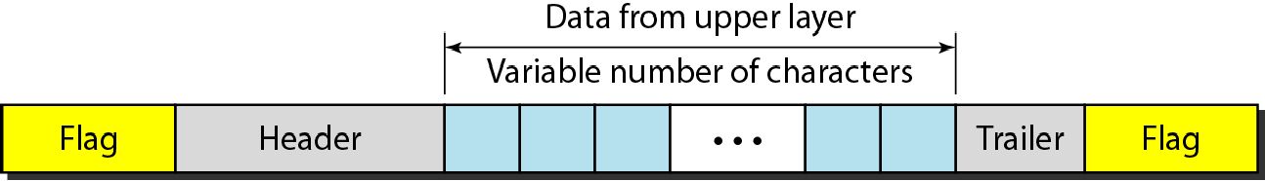
Figure 1 A frame in a character-oriented protocol

Slide 4
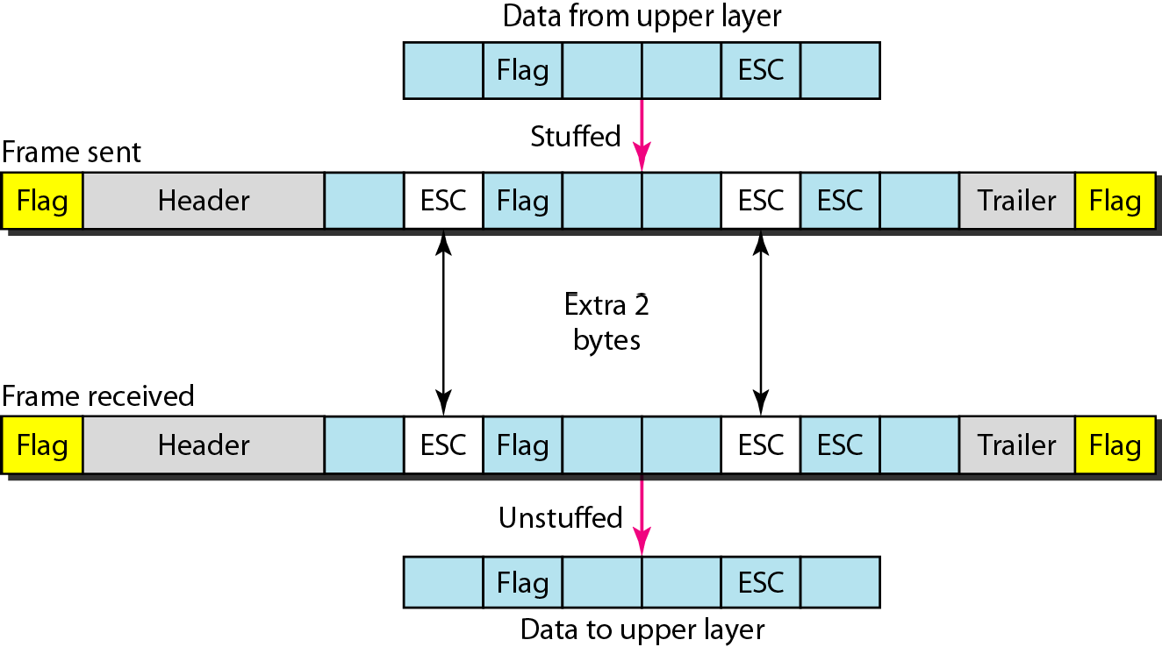
Figure 2 Byte stuffing and unstuffing

Slide 5

Note
Byte stuffing is the process of adding 1 extra byte whenever there is a flag or escape character in the text.

Slide 6
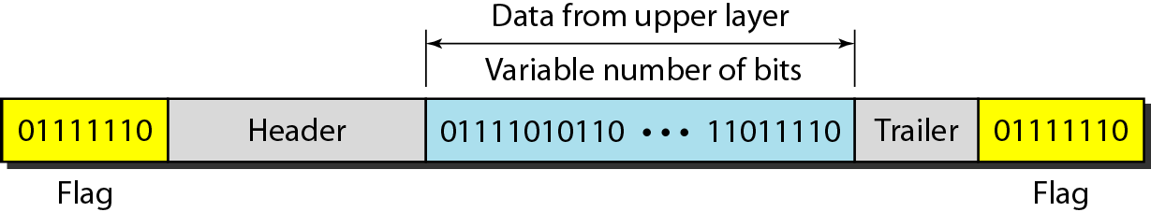
Figure 3 A frame in a bit-oriented protocol

Slide 7

Note
Bit stuffing is the process of adding one extra 0 whenever five consecutive 1s follow a 0 in the data, so that the receiver does not mistake
the pattern 0111110 for a flag.

Slide 8
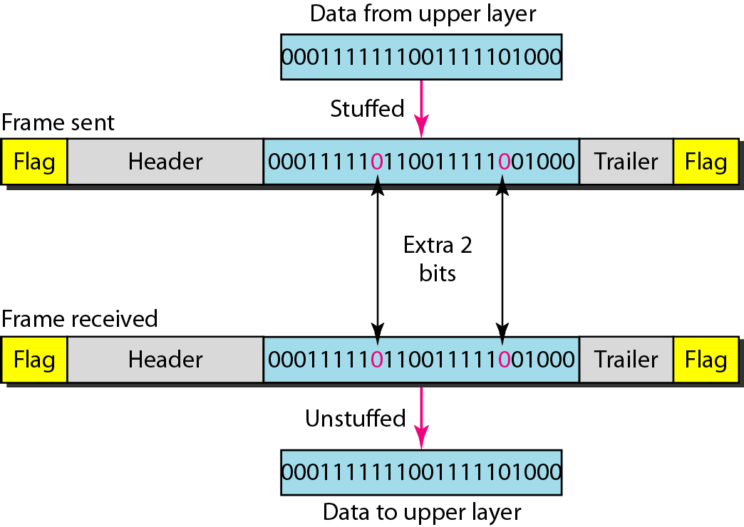
Figure 4 Bit stuffing and unstuffing

